Slide 1
Data Warehousing Development

Slide 2
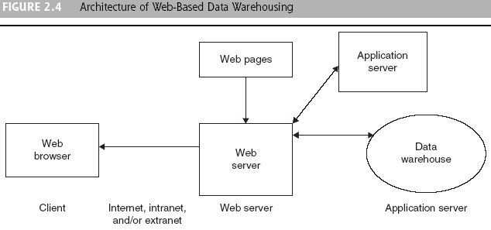
Data Warehousing Architectures
Web server manages the inflow and outflow of information between client and servers. This approach offers ease of access, platform independence, and lower cost

Slide 3
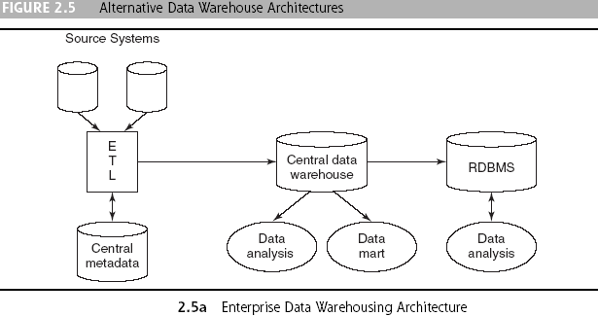
Data Warehousing Architectures

Slide 4
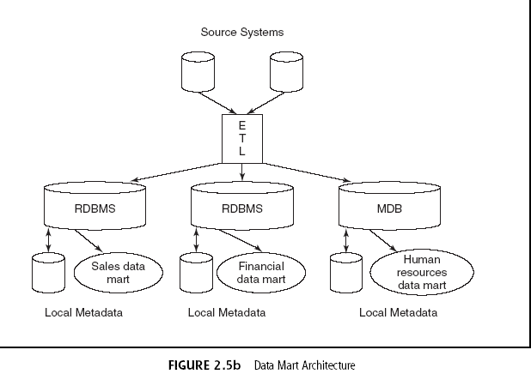
Data Warehousing Architectures

Slide 5
Data Warehousing Architectures
Ten factors that potentially affect the architecture selection decision:
Information interdependence between organizational units
Upper management’s information needs
Urgency of need for a data warehouse
Nature of end-user tasks
Constraints on resources
Strategic view of the data warehouse prior to implementation
Compatibility with existing systems
Perceived ability of the in-house IT staff
Technical issues
Social/political factors

Slide 6
Data Integration and the
Extraction, Transformation, and Load (ETL) Process
Data integration
Integration that comprises three major processes: data access, data federation, and change capture. When these three processes are correctly implemented, data can be accessed and made accessible to an array of ETL and analysis tools and data warehousing environments
  Bank of America Ex. (App. Case 2.2)

Slide 7
Data Integration and the
Extraction, Transformation, and Load (ETL) Process
Extraction, transformation, and load (ETL)
A data warehousing process that consists of extraction (i.e., reading data from a database), transformation (i.e., converting the extracted data from its previous form into the form in which it needs to be so that it can be placed into a data warehouse or simply another database), and load (i.e., putting the data into the data warehouse)

Slide 8
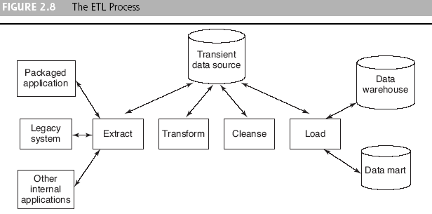
Data Integration and the
Extraction, Transformation, and Load (ETL) Process

Slide 9
Data Integration and the
Extraction, Transformation, and Load (ETL) Process
Issues affect whether an organization will purchase data transformation tools or build the transformation process itself
  Data transformation tools are expensive
  Data transformation tools may have a long learning curve
  It is difficult to measure how the IT organization is doing until it has learned to use the data transformation tools

Slide 10
Data Integration and the
Extraction, Transformation, and Load (ETL) Process
Important criteria in selecting an ETL tool
  Ability to read from and write to an unlimited number of data source architectures
  Automatic capturing and delivery of metadata
  A history of conforming to open standards
  An easy-to-use interface for the developer and the functional user

Slide 11
Data Warehouse Development
Direct benefits of a data warehouse
  Allows end users to perform extensive analysis
  Allows a consolidated view of corporate data (single version of the truth)
  Better and more timely information
  Enhanced system performance
  Simplification of data access

Slide 12
Data Warehouse Development
Indirect benefits result from end users using these direct benefits
  Enhance business knowledge
  Present competitive advantage (see Coke App. Case 2.3)
  Enhance customer service and satisfaction
  Facilitate decision making
  Help in reforming business processes

Slide 13
Data Warehouse Development
Data warehouse vendors (Table 2.1 list)
  Six guidelines to considered when developing a vendor list:
    Financial strength
    ERP linkages
    Qualified consultants
    Market share
    Industry experience
    Established partnerships

Slide 14
Data Warehouse Development
Data warehouse development approaches
  Inmon Model: EDW approach
    Top-down, relational DB tools
  Kimball Model: Data mart approach
    Bottom-up, dimensional modeling; plan big, build small
Which model is best?
  There is no one-size-fits-all strategy to data warehousing (Table 2.3 does a comparison)
  Could outsource: hosted warehouse
  HP consolidated DMs into EDW (App. 2.4)

Slide 15
Data Warehouse Development
Data warehouse structure: The Star Schema
  Dimensional modeling
  A retrieval-based system that supports high-volume query access
  Dimension tables
  A table that address how data will be analyzed (exs.: location, time, and size are dimensions that would support central fact rows)
  Fast query-response time, simplicity, ease of maintenance for read-only DB structures

Slide 16
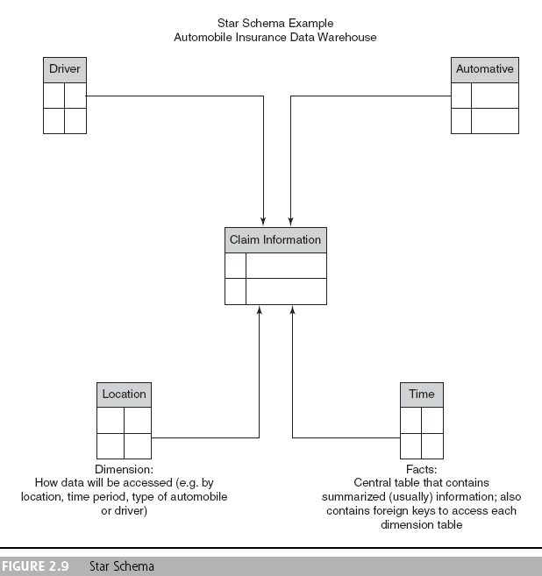
Data Warehouse Development

Slide 17
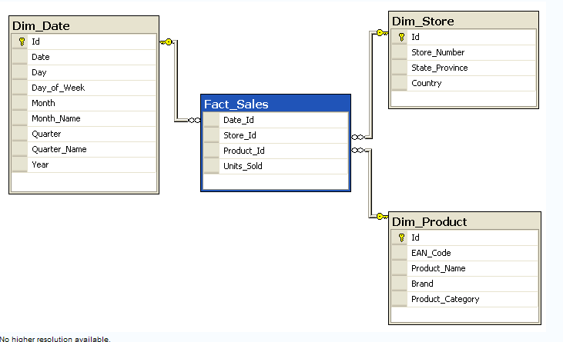
Star Schema Example

Slide 18
Data Warehouse Development
Grain
A definition of the highest level of detail that is supported in a data warehouse
Drill-down
The process of probing beyond a summarized value to investigate each of the detail transactions that comprise the summary

Slide 19
Data Warehouse Development
Data warehousing implementation issues
  Implementing a data warehouse is generally a massive effort that must be planned and executed according to established methods
  There are many facets to the project lifecycle, and no single person can be an expert in each area

Slide 20
Data Warehouse Development
Eleven major tasks that could be performed in parallel for successful implementation of a data warehouse (Solomon, 2005) :
Establishment of service-level agreements and data-refresh requirements
Identification of data sources and their governance policies
Data quality planning
Data model design
ETL tool selection
Relational database software and platform selection
Data transport
Data conversion
Reconciliation process
Purge and archive planning
End-user support

Slide 21
Data Warehouse Development
Some best practices for implementing a data warehouse (Weir, 2002):
  Project must fit with corporate strategy and business objectives
  There must be complete buy-in to the project by executives, managers, and users
  It is important to manage user expectations about the completed project
  The data warehouse must be built incrementally
  Build in adaptability

Slide 22
Data Warehouse Development
Some best practices for implementing a data warehouse (Weir, 2002):
  The project must be managed by both IT and business professionals
  Develop a business/supplier relationship
  Only load data that have been cleansed and are of a quality understood by the organization
  Do not overlook training requirements
  Be politically aware

Slide 23
Data Warehouse Development
Failure factors in data warehouse projects:
  Cultural issues being ignored
  Inappropriate architecture
  Unclear business objectives
  Missing information
  Unrealistic expectations
  Low levels of data summarization
  Low data quality

Slide 24
Data Warehouse Development
Issues to consider to build a successful data warehouse:
  Starting with the wrong sponsorship chain
  Setting expectations that you cannot meet and frustrating executives at the moment of truth
  Engaging in politically naive behavior
  Loading the warehouse with information just because it is available

Slide 25
Data Warehouse Development
Issues to consider to build a successful data warehouse:
  Believing that data warehousing database design is the same as transactional database design
  Choosing a data warehouse manager who is technology oriented rather than user oriented
  Focusing on traditional internal record-oriented data and ignoring the value of external data and of text, images, and, perhaps, sound and video

Slide 26
Data Warehouse Development
Issues to consider to build a successful data warehouse:
  Delivering data with overlapping and confusing definitions
  Believing promises of performance, capacity, and scalability
  Believing that your problems are over when the data warehouse is up and running
  Focusing on ad hoc data mining and periodic reporting instead of alerts

Slide 27
Data Warehouse Development
Implementation factors that can be categorized into three criteria
  Organizational issues
  Project issues
  Technical issues
User participation in the development of data and access modeling is a critical success factor in data warehouse development

Slide 28
Data Warehouse Development
Massive data warehouses and scalability
  The main issues pertaining to scalability:
    The amount of data in the warehouse
    How quickly the warehouse is expected to grow
    The number of concurrent users
    The complexity of user queries
  Good scalability means that queries and other data-access functions will grow linearly with the size of the warehouse

Slide 29
Real-Time Data Warehousing
Real-time (active) data warehousing (called RDW or ADW)
The process of loading and providing data via a data warehouse as they become available
  Supports operational decision-making

Slide 30
Real-Time Data Warehousing
Levels of data warehouses:
  Reports what happened
  Some analysis occurs
  Provides prediction capabilities,
  Operationalization
  Becomes capable of making events happen

Slide 31
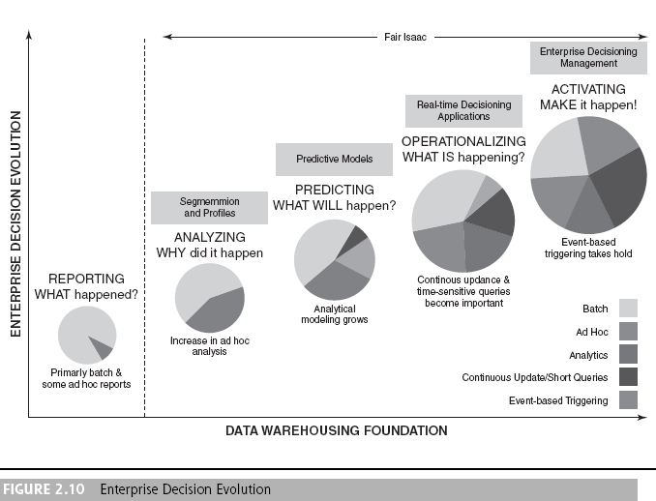
Real-Time Data Warehousing

Slide 32
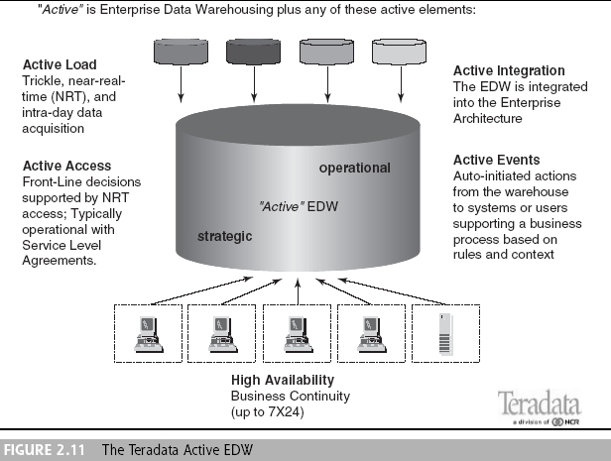
Real-Time Data Warehousing

Slide 33
Real-Time Data Warehousing
The need for real-time data
  A business often cannot afford to wait a whole day for its operational data to load into the data warehouse for analysis
  Provides incremental real-time data showing every state change and almost analogous patterns over time
  Maintaining metadata in sync is possible
  Less costly to develop, maintain, and secure one huge data warehouse so that data are centralized for BI/BA tools
  An EAI (Enterprise Application Integration) with real-time data collection can reduce or eliminate the nightly batch processes

Slide 34
Data Warehouse
Administration and Security Issues
Data warehouse administrator (DWA)
A person responsible for the administration and management of a data warehouse

Slide 35
Data Warehouse
Administration and Security Issues
Effective security in a data warehouse should focus on four main areas:
  Establishing effective corporate and security policies and procedures
  Implementing logical security procedures and techniques to restrict access
  Limiting physical access to the data center environment
  Establishing an effective internal control review process with an emphasis on security and privacy

